Slide 1
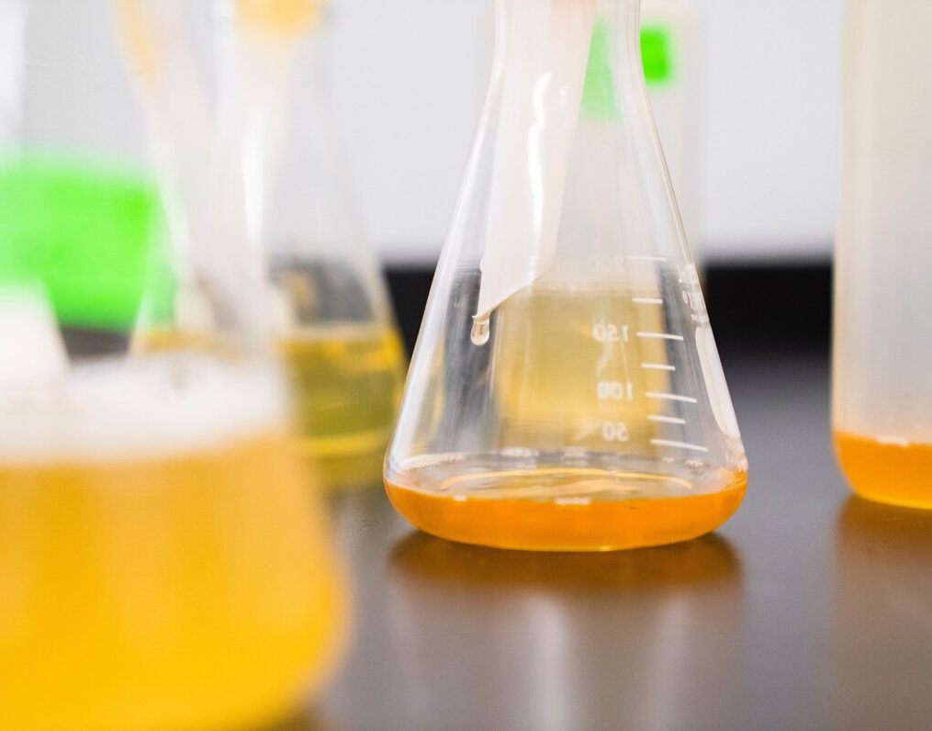
CHEMISTRY
Project contributors and more stuff

Slide 2

Awesome title here
Chemistry is the scientific study of the properties and behavior of matter.

Slide 3
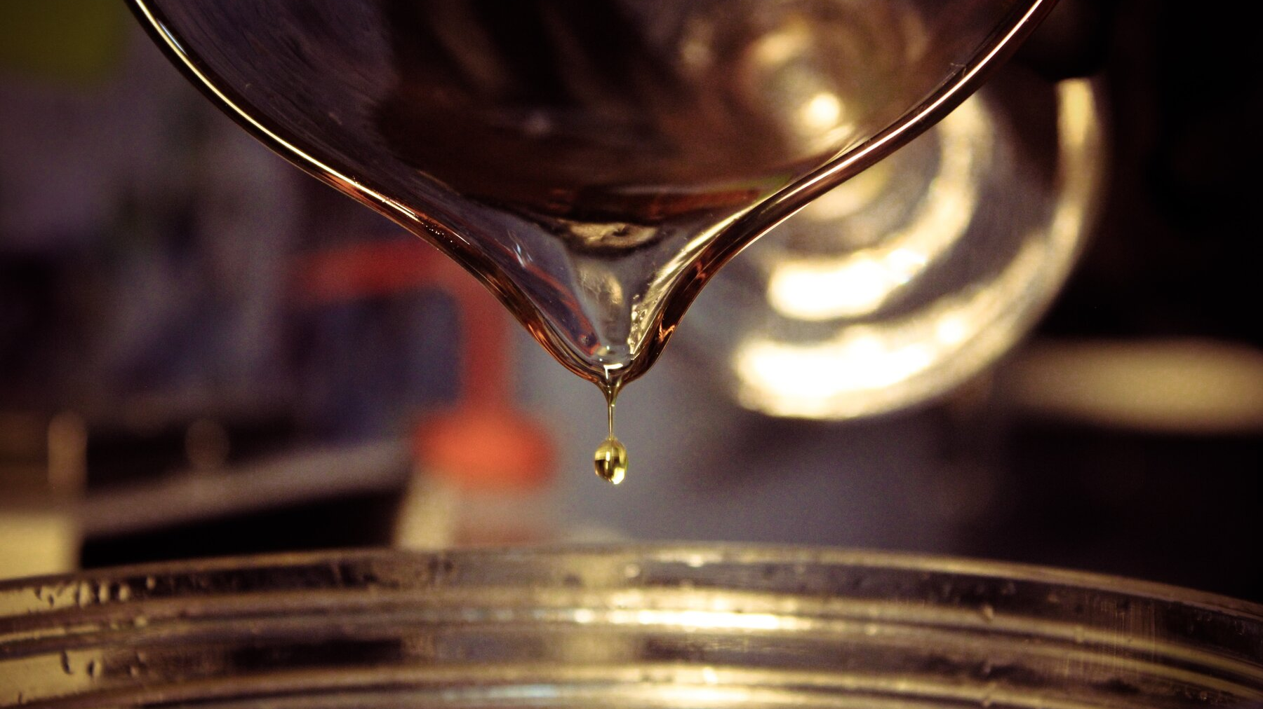
01
CHAPTER ONE
03
CHAPTER THREE
02
CHAPTER TWO
04
CHAPTER FOUR

Slide 4

“Stevia does something funny to the chemistry of my mouth. There's no fooling a taste bud, in my experience."
-Jonathan Franzen.
Section title here

Slide 5
Your awesome title here
Pathophysiology is the study of the physical and functional changes that occur during a disease process. In this e-module you will learn about the concept of pathophysiology, types of toxicity, repair and adaptation, and patterns of toxic injury.
Toxic insults can result in physical and biochemical alterations that may lead to cellular dysfunction, repair, adaptation, carcinogenesis and/or death.
Persistent toxic injury that does not result in death generally leads to attempts at repair of toxicant-induced damage.
Section title here

Slide 6
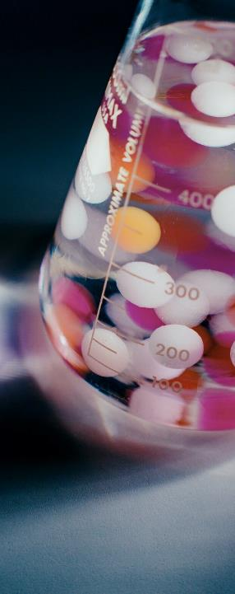
Here is a title
Most toxicants exert their effects on specific molecules, tissues or organs based on the physical and chemical makeup of the toxicant as well as the absorption, distribution and metabolism of the toxicant within the body.
Section title here

Slide 7

Section title here
induction
peroxidation
tolerance
downregulation
alteration of toxicant delivery to target sites
decreasing reactivity of target site to toxicant
increasing local repair processes
compensatory mechanisms to mitigate

Slide 8

Title 1
Discuss the differences between targeted and non-targeted toxicity.
Tile 2
Compared to covalent binding of a toxicant to its target molecule, noncovalent bonds tend to be stronger.
Title 3
Toxicants can act as enzymes, damaging cellular or tissue structures or interfering with normal cellular function.

Slide 9

title
Title
title
Electron transfer can result in oxidation of some endogenous macromolecules, altering their function. For example, chemicals that oxidize ferrous iron (Fe²⁺) to ferric iron (Fe³⁺) in the hemoglobin molecule cause a condition termed methemoglobinemia, resulting in lowered ability of the hemoglobin in red blood cells to deliver oxygen to body tissues.
Noncovalent binding between toxicant and target molecules form relatively weak, reversible bonds.
Non-targeted interactions include alterations in biological microenvironment of cell and tissues and impairment of normal function by physical obstruction or mechanical damage.
Toxicants can act as enzymes, damaging cellular or tissue structures or interfering with normal cellular function.

Slide 10
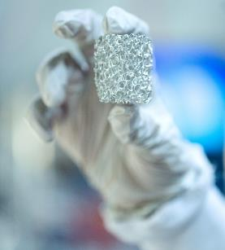
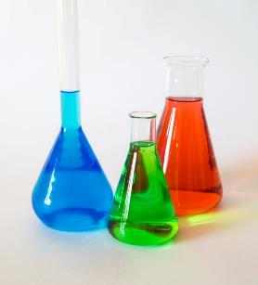
PROBLEM
Toxicants may interact with host molecules in a targeted or non-targeted fashion. Targeted interactions include covalent and noncovalent binding, electron transfer, hydrogen abstraction and enzymatic reactions.
SOLUTION
Section title here
Covalent bonding of toxicant and target molecules form adducts, which can cause physical or functional damage to macromolecules such as proteins and nucleic acids.

Slide 11
ICONS SET
You can resize these icons without losing quality.
You can change the stroke and fill color. Just select the icon and click on the paint bucket/pen.
EDUCATIONAL CONS
MEDICAL ICONS

Slide 12
EDITABLE MAP
You can resize this map without losing quality.
You can change the stroke and fill color. Just select the map and click on the paint bucket/pen.
Section title here

